Slide 1
The fundamentals of web system technologies

Slide 2
Overview on the following:
a. HTTP,
b. HTML
c. HTML 5 Tags,
d. Static and Dynamic web,
e. CSS & CSS 3 and;
f. JQuery
g. JavaScript

Slide 3
HTTP is a protocol for fetching resources such as HTML documents.
It is the foundation of any data exchange on the Web and it is a client-server protocol, which means requests are initiated by the recipient, usually the Web browser.
A complete document is reconstructed from the different sub-documents fetched, for instance, text, layout description, images, videos, scripts, and more.

Slide 4
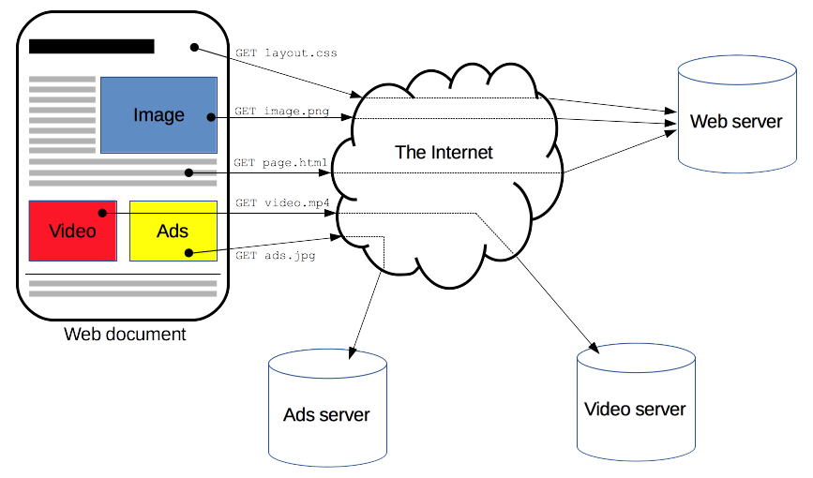
Clients and servers communicate by exchanging individual messages (as opposed to a stream of data). The messages sent by the client, usually a Web browser, are called requests and the messages sent by the server as an answer are called responses.

Slide 5
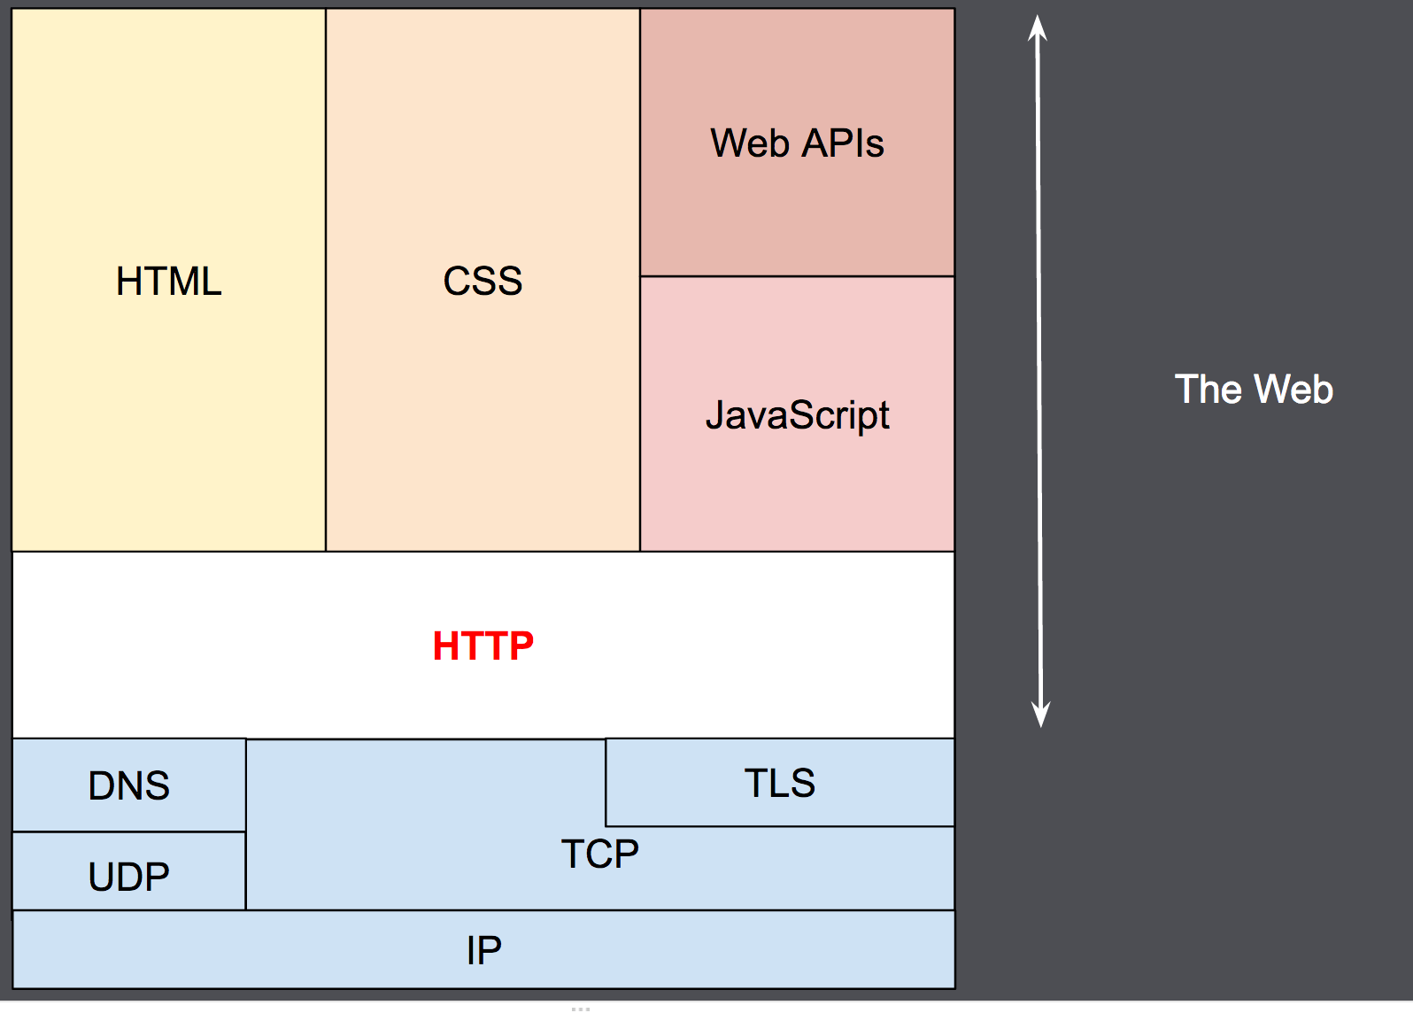
Designed in the early 1990s, HTTP is an extensible protocol which has evolved over time.
It is an application layer protocol that is sent over TCP (Transmission Control Protocol), or over a Transport Layer Security (TLS)-encrypted TCP connection, though any reliable transport protocol could theoretically be used.
Due to its extensibility, it is used to not only fetch hypertext documents, but also images and videos or to post content to servers, like with HTML form results.
HTTP can also be used to fetch parts of documents to update Web pages on demand.

Slide 6
Components of HTTP-based systems
HTTP is a client-server protocol: requests are sent by one entity, the user-agent (or a proxy on behalf of it). Most of the time the user-agent is a Web browser, but it can be anything, for example, a robot that crawls the Web to populate and maintain a search engine index.

Slide 7
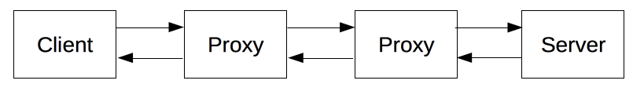
Each individual request is sent to a server, which handles it and provides an answer called the response. Between the client and the server there are numerous entities, collectively called proxies, which perform different operations and act as gateways or caches, for example.

Slide 8
Client: the user-agent
The user-agent is any tool that acts on behalf of the user. This role is primarily performed by the Web browser, but it may also be performed by programs used by engineers and Web developers to debug their applications.

Slide 9
A Web page is a hypertext document.
This means some parts of the displayed content are links, which can be activated (usually by a click of the mouse) to fetch a new Web page, allowing the user to direct their user-agent and navigate through the Web.
The browser translates these directions into HTTP requests, and further interprets the HTTP responses to present the user with a clear response.

Slide 10
The Web server
On the opposite side of the communication channel is the server, which serves the document as requested by the client.
A server appears as only a single machine virtually; but it may actually be a collection of servers sharing the load (load balancing), or other software (such as caches, a database server, or e-commerce servers), totally or partially generating the document on demand.

Slide 11
Proxies
Between the Web browser and the server, numerous computers and machines relay the HTTP messages.
Due to the layered structure of the Web stack, most of these operate at the transport, network or physical levels, becoming transparent at the HTTP layer and potentially having a significant impact on performance.

Slide 12
Proxies may perform numerous functions:
caching
filtering
load balancing
authentication
logging

Slide 13
Basic aspects of HTTP
HTTP is simple
HTTP is generally designed to be simple and human-readable, even with the added complexity introduced in HTTP/2 by encapsulating HTTP messages into frames.
HTTP messages can be read and understood by humans, providing easier testing for developers, and reduced complexity for newcomers.

Slide 14
HTTP is extensible
Introduced in HTTP/1.0, HTTP headers make this protocol easy to extend and experiment with.
New functionality can even be introduced by a simple agreement between a client and a server about a new header's semantics.

Slide 15
HTTP and connections
A connection is controlled at the transport layer, and therefore fundamentally out of scope for HTTP.
HTTP doesn't require the underlying transport protocol to be connection-based; it only requires it to be reliable, or not lose messages (at minimum, presenting an error in such cases).
Among the two most common transport protocols on the Internet, TCP is reliable and UDP isn't. HTTP therefore relies on the TCP standard, which is connection-based.

Slide 16
Conclusion
HTTP is an extensible protocol that is easy to use. The client-server structure, combined with the ability to add headers, allows HTTP to advance along with the extended capabilities of the Web.
Though HTTP/2 adds some complexity by embedding HTTP messages in frames to improve performance, the basic structure of messages has stayed the same since HTTP/1.0.
Session flow remains simple, allowing it to be investigated and debugged with a simple HTTP message monitor.

Slide 17
HTML: HyperText Markup Language
HTML (HyperText Markup Language) is the most basic building block of the Web. It defines the meaning and structure of web content.
Other technologies besides HTML are generally used to describe a web page's appearance/presentation (CSS) or functionality/behavior (JavaScript).
HTML uses "markup" to annotate text, images, and other content for display in a Web browser.
HTML markup includes special "elements" such as
<head>, <title>, <body>, <header>, <footer and many others.

Slide 18
An HTML element is set off from other text in a document by "tags", which consist of the element name surrounded by "<" and ">".
The name of an element inside a tag is case-insensitive. That is, it can be written in uppercase, lowercase, or a mixture.
For example, the <title> tag can be written as <Title>, <TITLE>, or in any other way.
However, the convention and recommended practice is to write tags in lowercase.

Slide 19
HTML5
The term HTML5 is essentially a buzzword that refers to a set of modern web technologies.
This includes the HTML Living Standard, along with JavaScript APIs to enhance storage, multimedia, and hardware access.

Slide 20
You may sometimes hear about "new HTML5 elements", or find HTML5 described as a new version of HTML.
HTML5 was the successor to previous HTML versions and introduced new elements and capabilities to the language on top of the previous version, HTML 4.01, as well as improving or removing some existing functionality.
However, as a Living Standard HTML now has no version.
Any modern site should use the HTML doctype — this will ensure that you are using the latest version of HTML.

Slide 21
HTML5 introduced several new tags to enhance the structure and semantics of web documents. Some commonly used HTML5 tags include:
<header>: Represents introductory content typically at the top of a section or page.
<nav>: Defines a section with navigation links.
<main>: Specifies the main content of a document.
<section>: Defines a section in a document.
<article>: Represents an independent piece of content within a document.
<aside>: Defines content aside from the content it is placed in.
<footer>: Represents a footer for its nearest section or article ancestor.
These tags help structure content more semantically and improve accessibility and SEO. For a comprehensive list of HTML5 tags, you can refer to the HTML element reference on MDN.

Slide 22
CSS (Cascading Style Sheets)
CSS (Cascading Style Sheets) is used to style and lay out web pages — for example, to alter the font, color, size, and spacing of your content, split it into multiple columns, or add animations and other decorative features.
This module provides a gentle beginning to your path towards CSS mastery with the basics of how it works, what the syntax looks like, and how you can start using it to add styling to HTML.

Slide 23
What is CSS
Presenting a document to a user means converting it into a form usable by your audience. Browsers, like Firefox, Chrome, or Edge, are designed to present documents visually, for example, on a computer screen, projector, or printer.
CSS can be used for very basic document text styling — for example, for changing the color and size of headings and links. It can be used to create a layout — for example, turning a single column of text into a layout with a main content area and a sidebar for related information. It can even be used for effects such as animation. Have a look at the links in this paragraph for specific examples.

Slide 24
CSS syntax
CSS is a rule-based language — you define the rules by specifying groups of styles that should be applied to particular elements or groups of elements on your web page.
For example, you can decide to have the main heading on your page to be shown as large red text. The following code shows a very simple CSS rule that would achieve the styling described above:
h1 {
color: red;
font-size: 5em;
}

Slide 26
It is the foundation of any data exchange on the Web and it is a client-server protocol
Designed in the early , HTTP is an extensible protocol which has evolved over time.
What does TCP stands for.
What does TLS stands for.

Slide 27
Between the Web browser and the server, numerous computers and machines relay the HTTP messages. what are those called.
Give 3 functions of proxies.
The is who respond to the user agent request.
It is any tool that acts on behalf of the user. Usually a web browser

Slide 28
http
1990s
Transmission control protocol
Transport layer security
Proxies
6-7-8. caching , filtering, load balancing, authentication, logging
9. Server/ web server
10. user agent/ client

